Slide 1



Custom Networking
(Part 2)
Sockets and Streams
Reference: tutorial-2015/networking/index.html

Slide 2
Objectives
Sockets and Streams
  TCP: A Reliable Protocol
  Sockets and Ports
  Client Sockets in Java
  Server Sockets in Java
  Object Streams and Serialization
  Serializable Objects
  Remote Control Using Object Streams
  Client Sever Demo

Slide 3
Understanding Ports - 1
The TCP and UDP protocols use ports to map incoming data to a particular process running on a computer.
server
P
o
r
t
TCP
Client
app
app
app
app
port
port
port
port
TCP or UDP
Packet
Data
port#
data

Slide 4
Understanding Ports - 2
Port is represented by a positive (16-bit) integer value
Some ports have been reserved to support common/well known services:
  ftp 21/tcp
  telnet 23/tcp
  smtp 25/tcp
  login 513/tcp
User level process/services generally use port number value >= 1024

Slide 5
Sockets
Sockets provide an interface for programming networks at the transport layer.
Network communication using Sockets is very much similar to performing file I/O
  In fact, socket handle is treated like file handle.
  The streams used in file I/O operation are also applicable to socket-based I/O
Socket-based communication is programming language independent.
  That means, a socket program written in Java language can also communicate to a program written in Java or non-Java socket program.

Slide 6
Socket Communication - 1
A server (program) runs on a specific computer and has a socket that is bound to a specific port. The server waits and listens to the socket for a client to make a connection request.
server
Connection request
port
Client

Slide 7
Socket Communication - 2
If everything goes well, the server accepts the connection. Upon acceptance, the server gets a new socket bounds to a different port. It needs a new socket (consequently a different port number) so that it can continue to listen to the original socket for connection requests while serving the connected client.
server
port
port
Client
port
Connection

Slide 8
Sockets and Java Socket Classes
A socket is an endpoint of a two-way communication link between two programs running on the network.
A socket is bound to a port number so that the TCP layer can identify the application that data destined to be sent.
Java’s .net package provides two classes:
  Socket – for implementing a client
  ServerSocket – for implementing a server

Slide 9

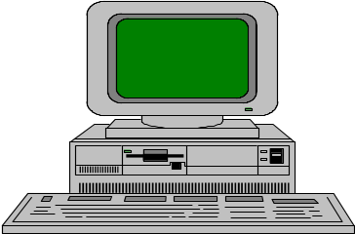
Java Sockets
Server
ServerSocket(1234)
Output/write stream
Client
Input/read stream
Socket(“128.250.25.158”, 1234)
It can be host_name like “mandroo.cs.mu.oz.au”

Slide 10
Implementing a Server
1. Open the Server Socket:
ServerSocket server;
DataOutputStream os;
DataInputStream is;
server = new ServerSocket( PORT );
2. Wait for the Client Request:
Socket client = server.accept();
3. Create I/O streams for communicating to the client
is = new DataInputStream(client.getInputStream() );
os = new DataOutputStream(client.getOutputStream() );
4. Perform communication with client
Receive from client: String line = is.readLine();
Send to client: os.writeBytes("Hello\n");
5. Close sockets: client.close();
For multithreaded server:
while(true) {
i. wait for client requests (step 2 above)
ii. create a thread with “client” socket as parameter (the thread creates streams (as in step (3) and does communication as stated in (4). Remove thread once service is provided.
}

Slide 11
Implementing a Client
1. Create a Socket Object:
client = new Socket(server, port_id);
2. Create I/O streams for communicating with the server.
is = new DataInputStream(client.getInputStream() );
os = new DataOutputStream(client.getOutputStream());
3. Perform I/O or communication with the server:
  Receive data from the server:
String line = is.readLine();
  Send data to the server:
os.writeBytes("Hello\n");
4. Close the socket when done:
client.close();

Slide 12
A simple server (simplified code)
// SimpleServer.java: a simple server program
import java.net.*;
import java.io.*;
public class SimpleServer {
public static void main(String args[]) throws IOException {
// Register service on port 1234
ServerSocket s = new ServerSocket(1234);
Socket s1=s.accept(); // Wait and accept a connection
// Get a communication stream associated with the socket
OutputStream s1out = s1.getOutputStream();
DataOutputStream dos = new DataOutputStream (s1out);
// Send a string!
dos.writeUTF("Hi there");
// Close the connection, but not the server socket
dos.close();
s1out.close();
s1.close();
}
}

Slide 13
A simple client (simplified code)
// SimpleClient.java: a simple client program
import java.net.*;
import java.io.*;
public class SimpleClient {
public static void main(String args[]) throws IOException {
// Open your connection to a server, at port 1234
Socket s1 = new Socket("mundroo.cs.mu.oz.au",1234);
// Get an input file handle from the socket and read the input
InputStream s1In = s1.getInputStream();
DataInputStream dis = new DataInputStream(s1In);
String st = new String (dis.readUTF());
System.out.println(st);
// When done, just close the connection and exit
dis.close();
s1In.close();
s1.close();
}
}

Slide 14
Run
Run Server:
  java SimpleServer
Run Client:
  java SimpleClient
  Hi there
If you run client when server is not up, the output like below will be displayed:
  sockets [1:147] java SimpleClient
  Exception in thread "main" java.net.ConnectException: Connection refused
  at java.net.PlainSocketImpl.socketConnect(Native Method)
  at java.net.PlainSocketImpl.doConnect(PlainSocketImpl.java:320)
  at java.net.PlainSocketImpl.connectToAddress(PlainSocketImpl.java:133)
  at java.net.PlainSocketImpl.connect(PlainSocketImpl.java:120)
  at java.net.Socket.<init>(Socket.java:273)
  at java.net.Socket.<init>(Socket.java:100)
  at SimpleClient.main(SimpleClient.java:6)

Slide 15
Socket Exceptions
ServerSocket & Socket Exceptions
ServerSocket Exception
public ServerSocket(int port) throws IOException
try {
Socket client = new Socket(host, port); handleConnection(client);
}
catch(UnknownHostException uhe) { System.out.println("Unknown host: " + host); uhe.printStackTrace();
}
catch(IOException ioe) {
System.out.println("IOException: " + ioe); ioe.printStackTrace();
}

Slide 16
Multithreaded Server: For Serving Multiple Clients Concurrently
Client 1 Process
Server Process
Server
Threads
Internet
Client 2 Process

Slide 17
Client and Server
Servers are capable of offering a variety of services.
Servers keep track of the services they offer by associating each service with a number, known as the port number .
A client that wants to make use of a server needs to know the desired port number, as well as the hostname or IP address of the server.

Slide 18
Client Sockets in Java
The java.net.Socket class contains code that knows how to find and communicate with a server. The communication uses TCP, so it is reliable.
Construct a client socket:
public Socket(String servername, int portNumber)

Slide 19
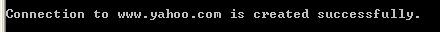
Example for creating a socket
import java.net.*;
public class Main
{ public static void main(String[] args)
{ Socket s; String strHost;
strHost = "www.yahoo.com";
final int nPort = 80;
try
{ s = new Socket(strHost, nPort);
System.out.println("Connection to "+strHost + " is created successfully.");
}
catch(UnknownHostException e)
{ System.out.println("Exception: " + e.getMessage()); }
catch(Exception e)
{ System.out.println("Exception: " + e.getMessage()); }
}
}

Slide 20
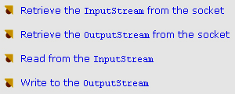
Reading from/ Writing to a Socket
Application
Socket
var1
InputStream
var2
OutputStream
Socket s = new Socket("www.fpt.vn", 80);
// Create stream to read data from the connected server
DataInputStream in = new DataInputStream(s.getInputStream());
// Create stream to write data to the connected server
DataOutputStream out = new DataOutputStream(s.getOutputStream());

Slide 21
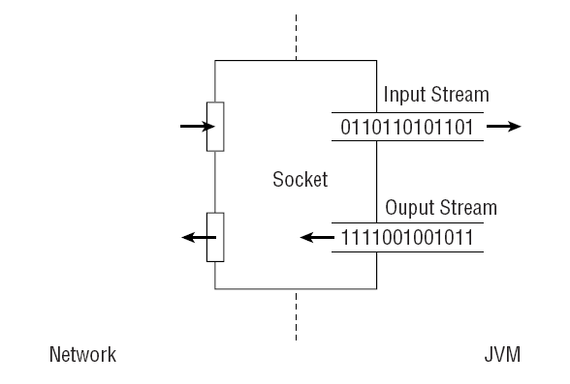
A socket and its streams

Slide 22
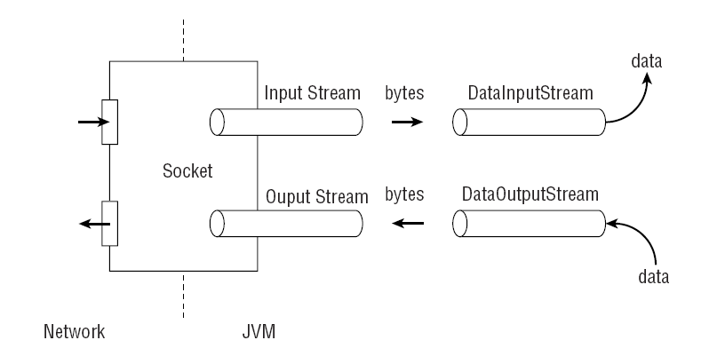
A socket with chained streams
// Get the streams.
OutputStream ostr = sock.getOutputStream();
DataOutputStream dostr = new DataOutputStream(ostr);
InputStream istr = sock.getInputStream();
DataInputStream distr = new DataInputStream(istr);

Slide 23
Server Sockets in Java
A client always gets to assume that a server is available. You can see this assumption at work when you construct a Socket instance (the constructor automatically connects to the specified server’s specified port).
A server, on the other hand, makes itself available and then waits for clients to initiate connections. This is done with an abstraction called a server socket (java.net.ServerSocket)

Slide 24
Server
Construct:
public ServerSocket(int portNumber)
To make the new object available for client connections, call its accept() method, which returns an instance of Socket
try {
ServerSocket ss = new ServerSocket(1234);
Socket sock = ss.accept();
. . .
}
catch (IOException x) {
System.out.println(“Stress: “ + x.getMessage());
}

Slide 25
Server…
There is no way to know how long the accept() call will take.
Once a client connects, the accept() method constructs and returns an instance of Socket.
Socket accept()
Listens for a connection to be made to this socket and accepts it.

Slide 26
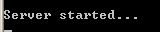
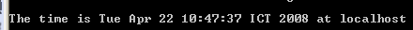
Example for creating connection using Socket
Step 1: java TimeServer
Step 2: java TimeClient
import java.net.*;
import java.io.*;
import java.util.Date;
public class TimeServer
{ public final static int timePort = 13;
public static void main(String [] args)
{ ServerSocket sckServer;
Socket sckClient;
PrintStream ps;
try
{ sckServer = new ServerSocket(timePort);
System.out.println("Server started...");
while(true)
{ sckClient = sckServer.accept();
ps = new PrintStream(sckClient.getOutputStream());
ps.println(new Date());
sckClient.close();
}
}
catch(IOException e)
{ System.err.println(e);
}
}
}
import java.net.*;
import java.io.*;
import java.util.Date;
public class TimeClient
{ public final static int timePort = 13;
public static void main(String [] args)
{ Socket sckClient;
String strHostName;
BufferedReader br;
if(args.length>0) strHostName=args[0]; else strHostName="localhost";
try
{ sckClient = new Socket(strHostName,13);
br = new BufferedReader(new InputStreamReader(sckClient.getInputStream()));
String showTime = br.readLine();
System.out.println("The time is " + showTime + " at " + strHostName);
}
catch(UnknownHostException e)
{ System.err.println(e); }
catch(IOException e)
{ System.err.println(e); }
}
}

Slide 27
Object Streams and Serialization
Stream allow you to read and write individual bytes.
Data streams allow you to read and write primitives and strings.
Object streams go one step beyond data streams by allowing you to read and write entire objects.

Slide 28
Remote Control Using Object Streams
The straightforward way to build a remote-control system is to create a class that represents a command.
The client can issue commands to the server by writing an instance of a command object to an Object Output Stream that is connected to the server.
The server can interpret the command object, take appropriate action, and if necessary send some kind of response object back to the client.

Slide 29
Summary
Sockets and Streams
  TCP: A Reliable Protocol
  Sockets and Ports
  Client Sockets in Java
  Server Sockets in Java
  Object Streams and Serialization
  Serializable Objects
  Remote Control Using Object Streams
  Client – Server demo
Q&A

